Slide 1
Spin ½ : 2-level system.
|β>
E_{β}=γ_{Ν} ħB₀/2
E
P_{αβ}
|α>
E_{α}=−γ_{Ν} ħB₀/2
B₀

Slide 2
|β>
W_{αβ}
P
P
W_{βα}
|α>

Slide 3
|β>
E_{β}=γ_{Ν} ħB₀/2
E
|α>
E_{α}=−γ_{Ν} ħB₀/2
B₀

Slide 4
B₀
e⁻

Slide 5
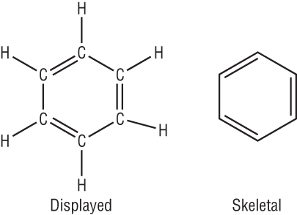
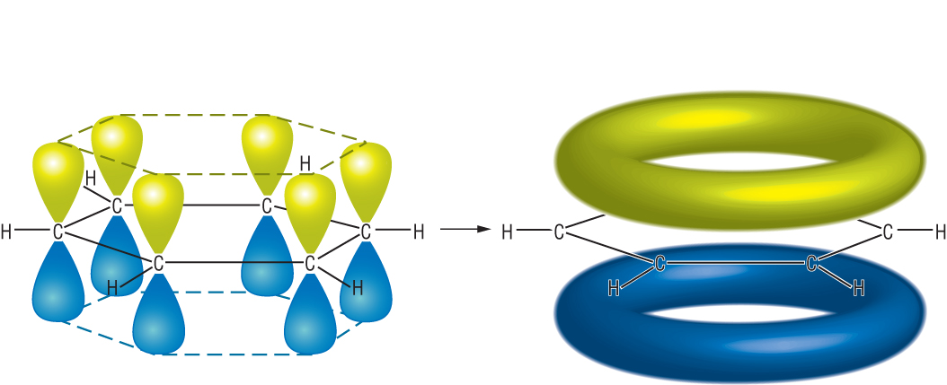
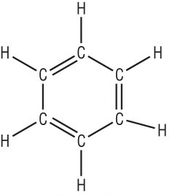
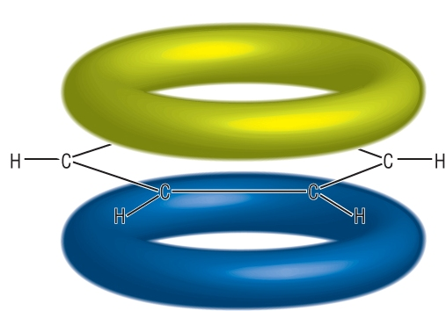
http://www.chemhume.co.uk/A2CHEM/Unit%201/2%20Arenes/chapter_2__arenesc.htm
e⁻
B''

Slide 6
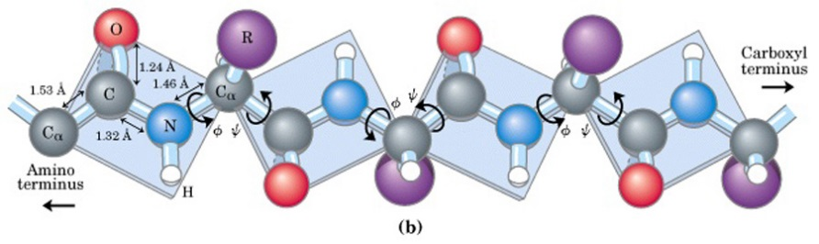
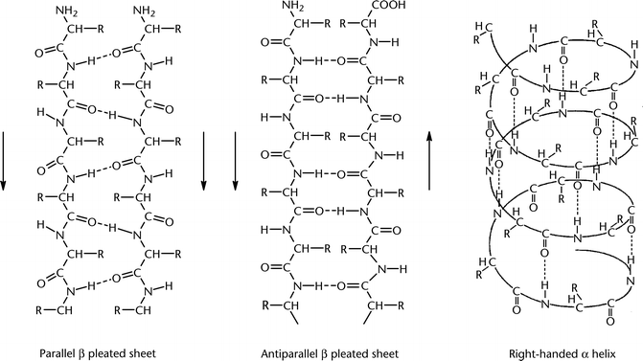

Slide 7
Pauli principle
nucleus 2
nucleus 1
Fermi contact interaction
Fermi contact interaction

Slide 8
β_{A}β_{B}
Ε₄=ν_{A}/2 + ν_{B}/2 +J/4
Allowed transitions
ν_{B}
β_{A}α_{B}
Ε₃=−ν_{A}/2 + ν_{B}/2 -J/4
ν_{A}
Ε₂=−ν_{B}/2 + ν_{A}/2 -J/4
α_{A}β_{B}
ν_{B}
α_{A}α_{B}
Ε₁=−ν_{A}/2 - ν_{B}/2 +J/4

Slide 9
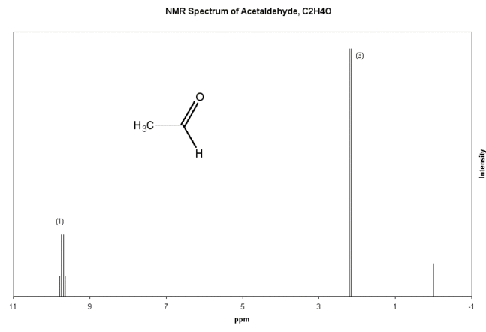
1
3
3
1
1
2
1
J
1
1
ν_{A}

Slide 10
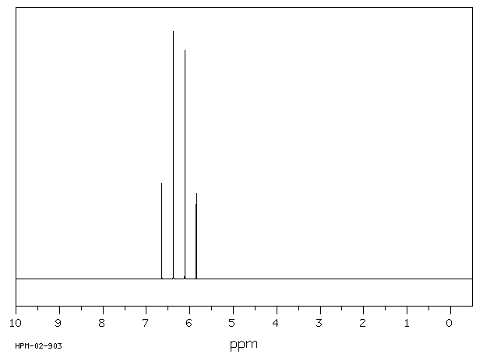
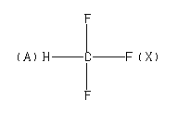
¹H NMR spectrum
J_{HF} = 79 Hz

Slide 11
φ₄ =β_{A}β_{B}
Allowed transitions
ν_{B}
φ₃
ν_{A}
φ₂
ν_{B}
φ₁ = α_{A}α_{B}

Slide 12
J<<δ
δ << J
(A)
2C
(B)
δ
(C)
δ²/2J
J
J
J
J
2<->1
4<->3
ν
3<->1
4<->2
ν
-J
ν
J

Slide 13
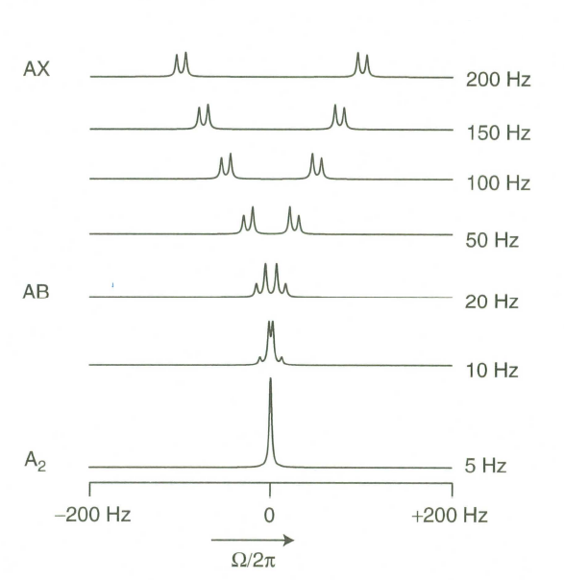
ν_{A}
ν_{B}
ν_{A}-ν_{B}
J

Slide 14
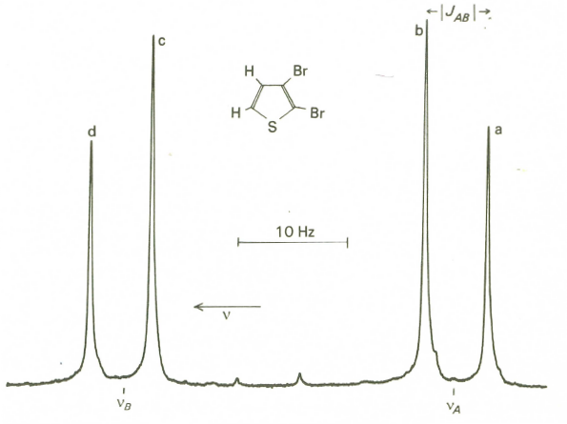

Slide 15
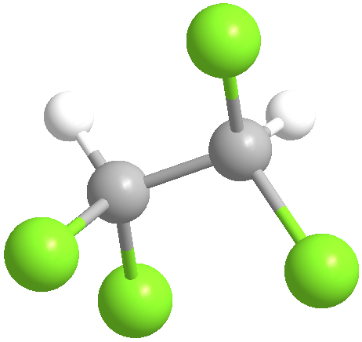
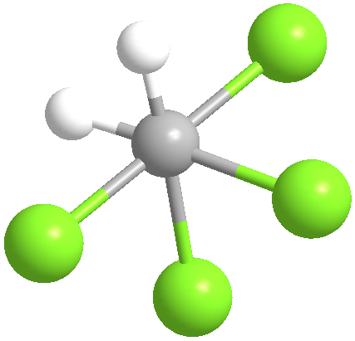
C₂H₂Cl₄
φ

Slide 16
H
R₄
φ
H
R₂
R₁
R₃

Slide 17
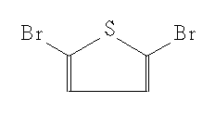
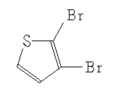
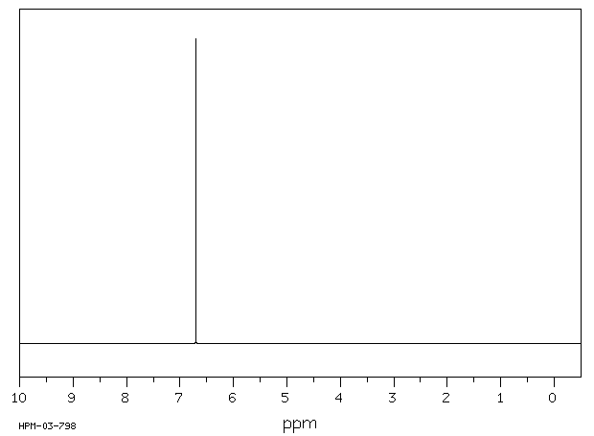
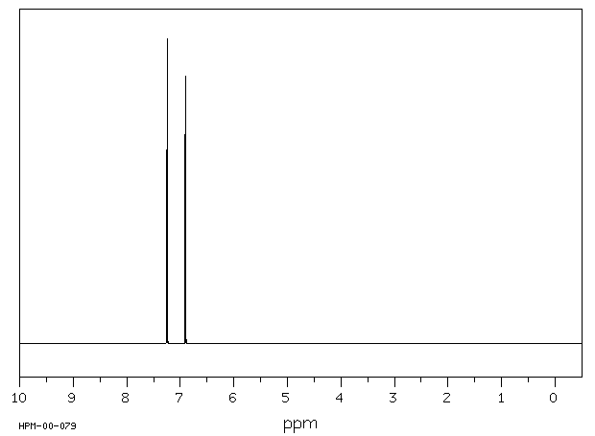
2,5 -dibromothiophene
2,3 -dibromothiophene

Slide 19
J<<δ
δ << J
(A)
2C
(B)
δ
(C)
δ²/2J
J
J
J
J
2<->1
4<->3
ν
3<->1
4<->2
ν
-J
ν
J

Slide 20
Δ<<ν₁-ν₂
ν₁=ν₂
(A)
(B)
Δ
Δ
Δ
ν₁
ν₂
ν₂=ν₁

Slide 22
Δ<<ν₁-ν₂
ν₁=ν₂
(A)
(B)
Δ
Δ
Δ
ν₁
ν₂
ν₂=ν₁
2Δ₀
2Δ₀
3Δ₀
Δ₀
Δ₀
3/2Δ₀
ν₁
ν₂
ν₂=ν₁

Slide 25
Ω
Z
B
r_{ij}
α
γ_{ΑΒ}
A
Y
X
φ_{ΑΒ}

Slide 26
B₀
σ₃
θ
σ₁
φ
σ₂

Slide 27
e⁻
nucleus 1
nucleus 2
Electric field gradient along the bond

Slide 28
Zeeman
Quadrupolar
1/2<->-1/2
m_{I}=-3/2
χ/8(3cos²θ-1)
m_{I}=-1/2
1/2<->3/2
1/2<->3/2
χ/8(3cos²θ-1)
m_{I}=1/2
χ/8(3cos²θ-1)
m_{I}=3/2
ν₀
χ/8(3cos²θ-1)
χ/2

Slide 29
Pb(NO₃)₂

Slide 30
(A)
(B)
Pb(NO₃)₂

Slide 31
Zero magnetic field
m_{I}=±3/2
χ/4(3cos²θ-1)
m_{I}=±1/2

Slide 32
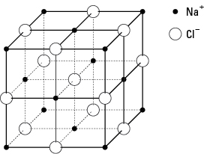
NaNO₂
NaCl

Slide 33
(A)
~
(B)
Z,Z
H₁
ωt
ωt
H₁cosωt
Y
H₁
~
ωt
~
X
Y
ωt
X
(C)
~
(D)
~
H₀
Z
Z
Ω/γ
H_{eff}
H_{eff}
~
~
Y
θ=γH_{eff}t_{p}
Y
H₁
~
~
X
X

Slide 34
~
~
(A)
(B)
Z
(C)
Z
B₀
Ω/γ
B₁
ωt
B_{eff}
B_{eff}
ωt
~
θ=γΒ_{eff}t_{p}
~
B₁cosωt
Y
Y
B₁
B₁
~
~
X
X

Slide 35
B₁
ωt
ωt
B₁cosωt
B₁

Slide 36
~
B₀
Z
Ω/γ
B_{eff}
~
Y
B₁
~
X

Slide 37
~
Z
B_{eff}
θ=γΒ_{eff}t_{p}
~
Y
~
X

Slide 38
(A)
(B)
(C)
γB₁t_{p}=π/2
γB₁t_{p}=π

Slide 39
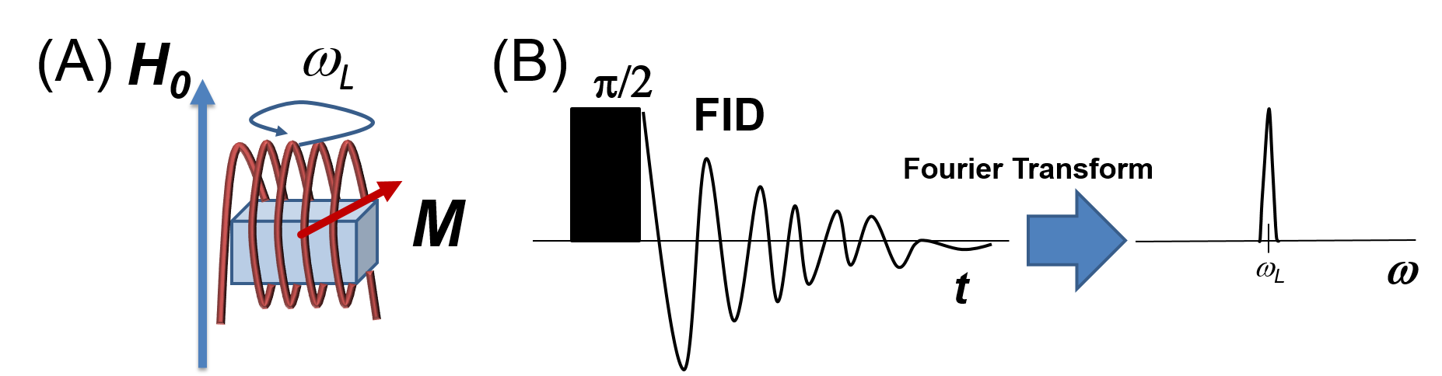

Slide 40
B₀
ω₀
M

Slide 41
(A)
(C)
(B)

Slide 42
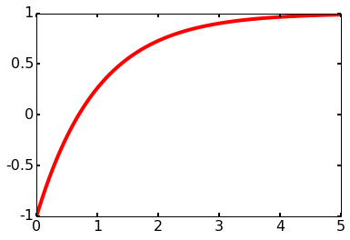
D
C
M_{z}=M₀(1-2exp(-t/T₁))
T₁= 1 s
M_{z}, a.u.
B
A
t, sec
A
B
C
D
Z'
Z'
Z'
Z'
M
M
Y'
Y'
Y'
Y'
θ=π
M
X'
X'
X'
X'
M

Slide 43
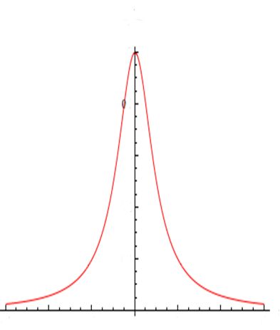
FID
π/2
1/πT₂
Fourier Transform
t
ν₀
ν
~exp(t/T₂)

Slide 44
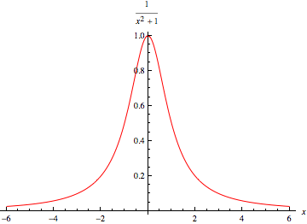

Slide 45
π/2
π
echo
FID
t
0
τ
2τ

Slide 46
(A)
(B)
After 1st pulse
Between 1st and 2nd pulses
Y
Y
π/2
π
echo
X
X
FID
φ=0
φ=Δωτ
t
After 2nd pulse
At t = τ
0
τ
2τ
Y
Y
X
X
φ=π−Δωτ+(t−τ)
φ=π

Slide 47
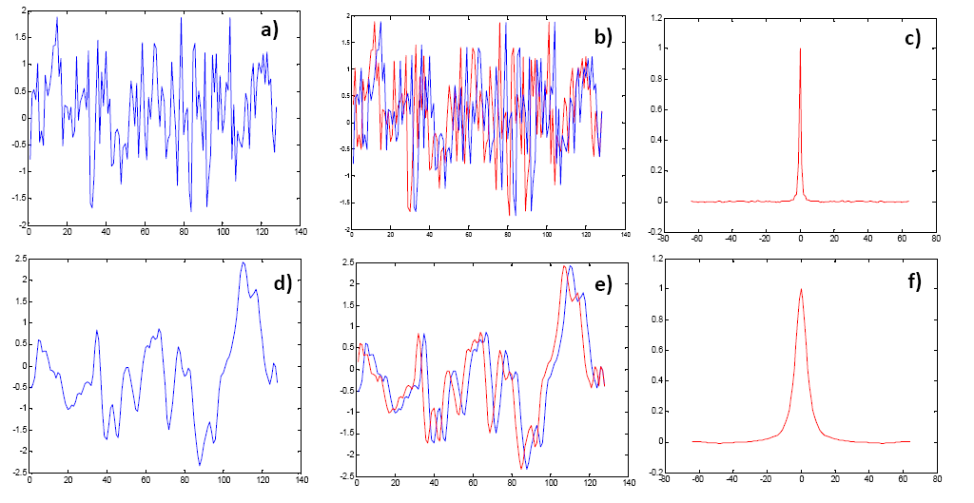

Slide 50
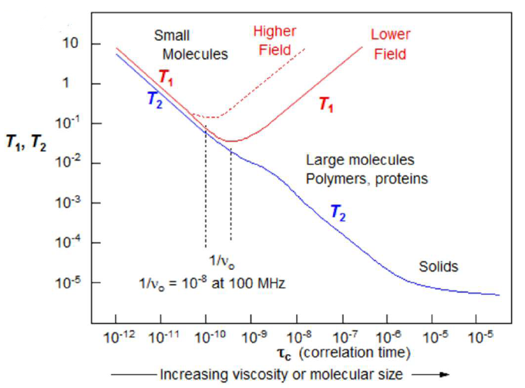

Slide 52
(1)
(1')
(2)
(2')
(3)
(3')
t₁
τ
t₂
(4)
Slow exchange rate
δ ~0
Fast exchange rate
δ ~1
ν₁
ν₁
ν_{B}
ν_{B}
ν_{A}
ν_{A}
ν₂
ν₂
ν_{A}
ν_{B}
ν_{A}
ν_{B}

Slide 53
Slow exchange
rate
Faster exchange
rate

Slide 54
0
ν₁
10
20
30
40
Hz
0
10
20
30
40
Hz
ν₂

Slide 55
|4>=|ββ>
W₃₄
W₂₄
W₁₄
|3>=|βα>
W₂₃
|2>=|β>
W₁₃
W₁₂
|1>=|αα>

Slide 56
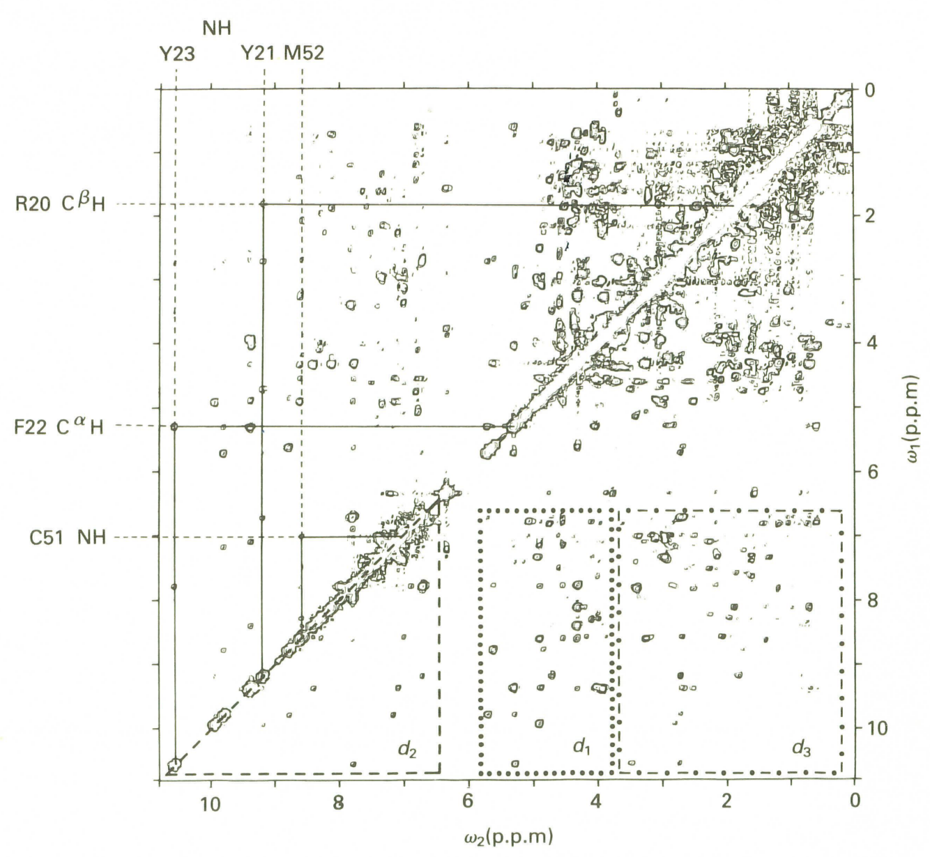
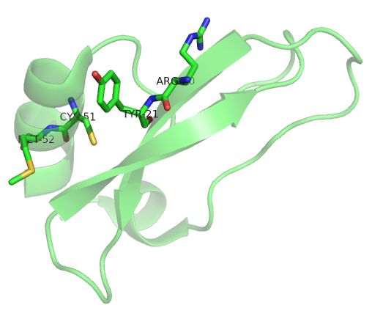
(1)
(1')
(2)
(2')
(3)
(3')
t₁
τ
t₂
(4)

Slide 58
B_{z}-B₀
G_{x}
ρ(x,y)
x
P(x)
Δω
γG_{x}
x
x

Slide 59
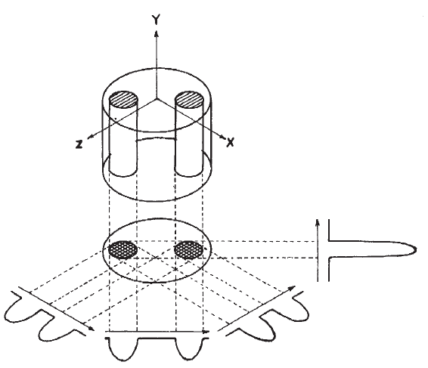
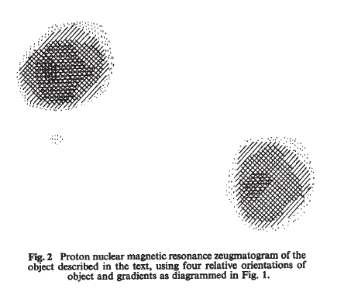

Slide 60
RF
Acquisition
ω=γG_{y}y
ω=γG_{x}x
1
1
G_{y}
2
3
t_{y}
G_{x}
2
t_{x}
3

Slide 61

ω₀
B(z)= B₀+ G_{z}z

